Slide 1

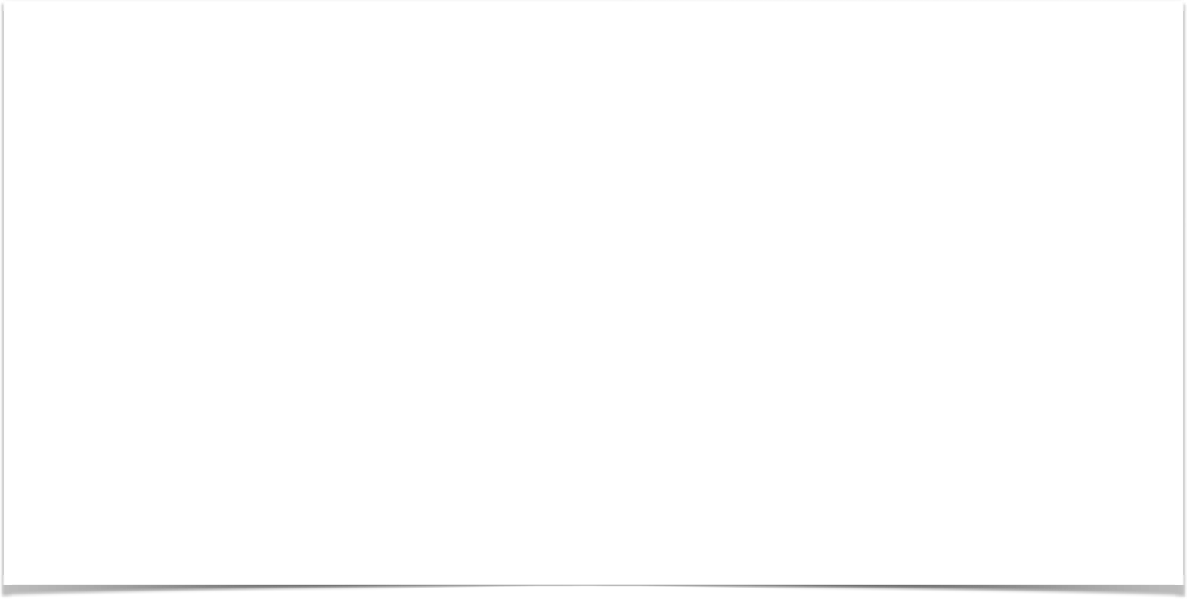

Developing
Spring Controllers and Views
Date

Slide 2
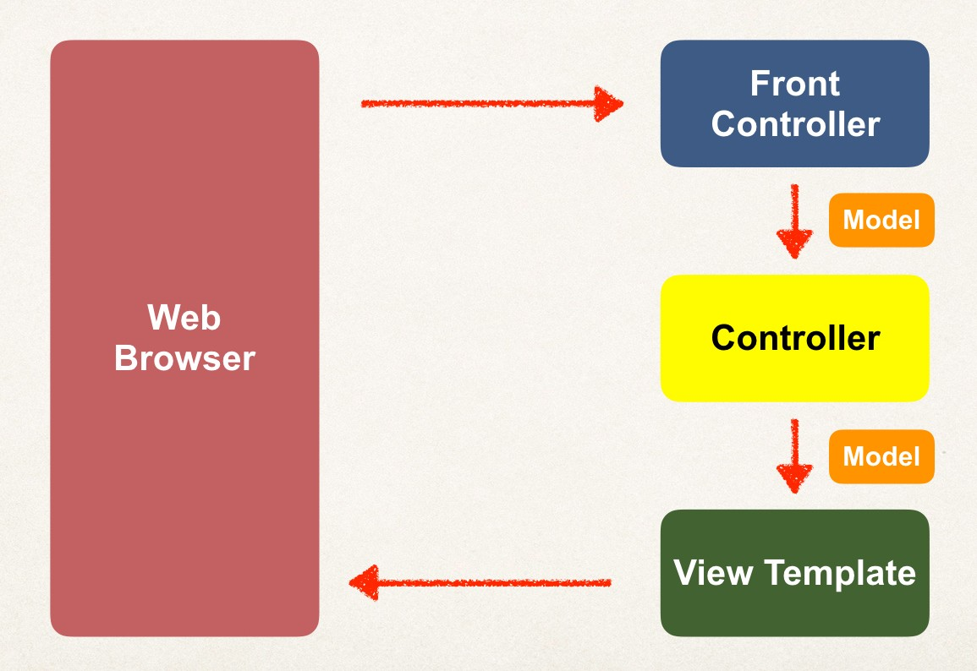



Our First Spring MVC Example
Request Path:
/
HomeController
main- menu.jsp
www.luv2code.com

Slide 3
Development Process
Step-By-Step
Create Controller class
Define Controller method
Add Request Mapping to Controller method
Return View Name
Develop View Page
www.luv2code.com

Slide 4

Step 1: Create Controller class
Annotate class with @Controller
@Controller inherits from @Component … supports scanning
@Controller
public class HomeController {
}
www.luv2code.com

Slide 5
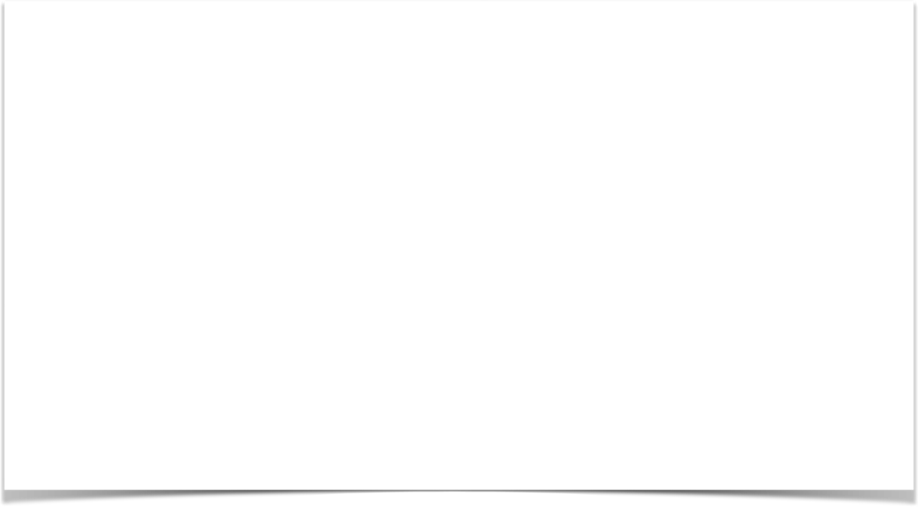
Step 2: Define Controller method
@Controller
public class HomeController {
public String showMyPage() {
…
}
}
www.luv2code.com

Slide 6
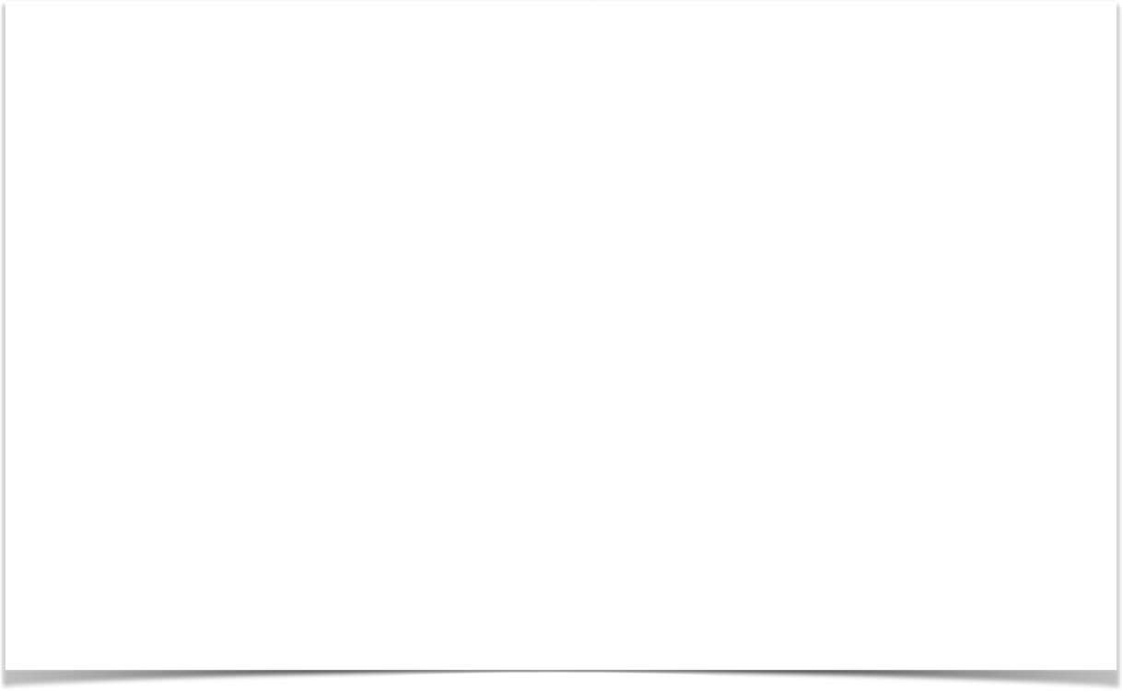
Step 3: Add Request Mapping to Controller method
@Controller
public class HomeController {
@RequestMapping("/") public String showMyPage() {
…
}
}
www.luv2code.com

Slide 7
Step 4: Return View Name
@Controller
public class HomeController {
@RequestMapping("/")
public String showMyPage() {
return "main-menu";
}
}
www.luv2code.com

Slide 8
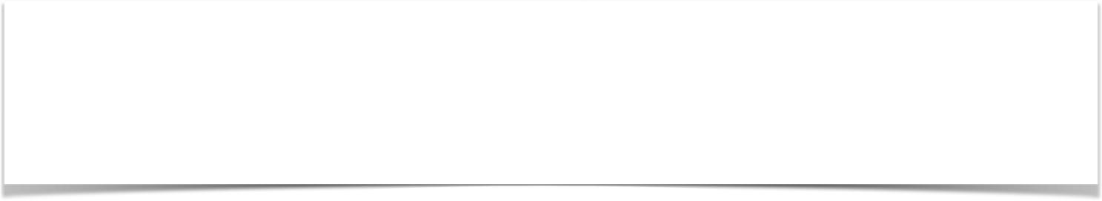

Finding the View Page
<bean
class="org.springframework.web.servlet.view.InternalResourceViewResolver">
<property name="prefix" value="/WEB-INF/view/" />
<property name="suffix" value=".jsp" />
</bean>
/WEB-INF/view/main-menu.jsp
View name
www.luv2code.com

Slide 9
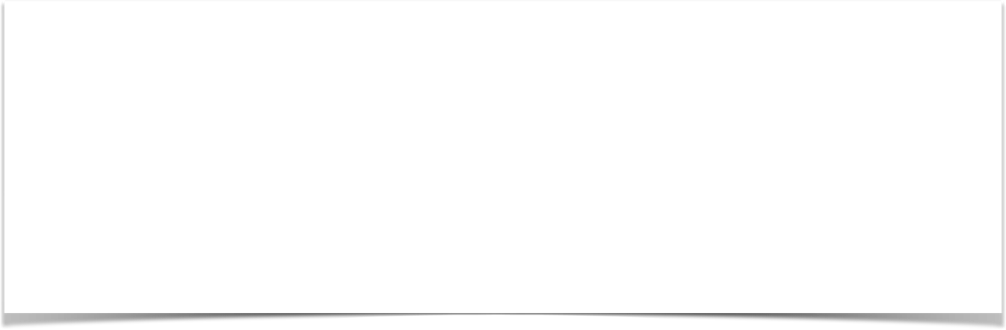
Step 5: Develop View Page
File: /WEB-INF/view/main-menu.jsp
<html><body>
<h2>Spring MVC Demo - Home Page</h2>
</body></html>
www.luv2code.com

Slide 10
Reading Form Data with Spring MVC
Date

Slide 11
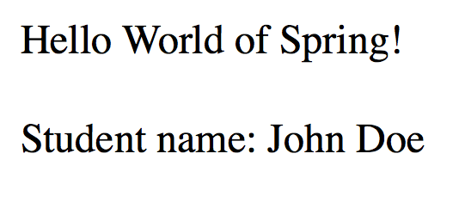
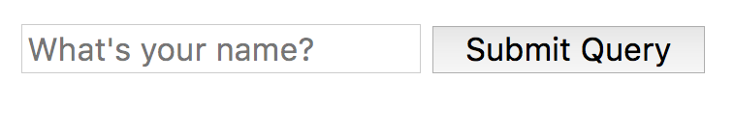

High Level View
helloworld.jsp
helloworld-form.jsp
www.luv2code.com

Slide 12
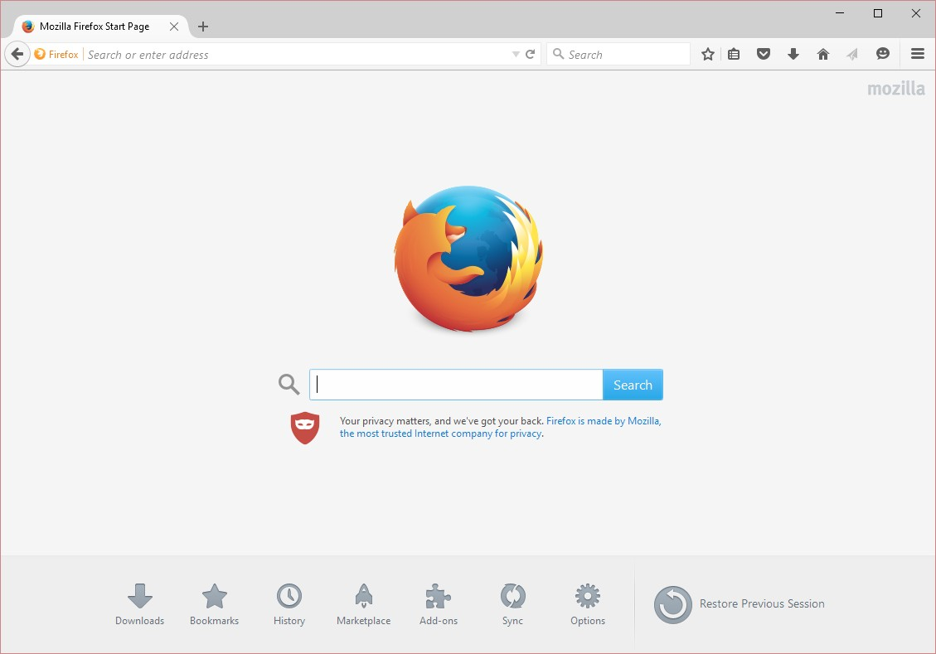



Application Flow
Request Mapping
helloworld-form.jsp
/showForm
HelloWorld Controller
www.luv2code.com

Slide 13




Application Flow
Request Mapping
helloworld-form.jsp
/showForm
HelloWorld Controller
Request Mapping
/processForm
helloworld.jsp
helloworld-form.jsp
HelloWorld Controller
www.luv2code.com

Slide 14
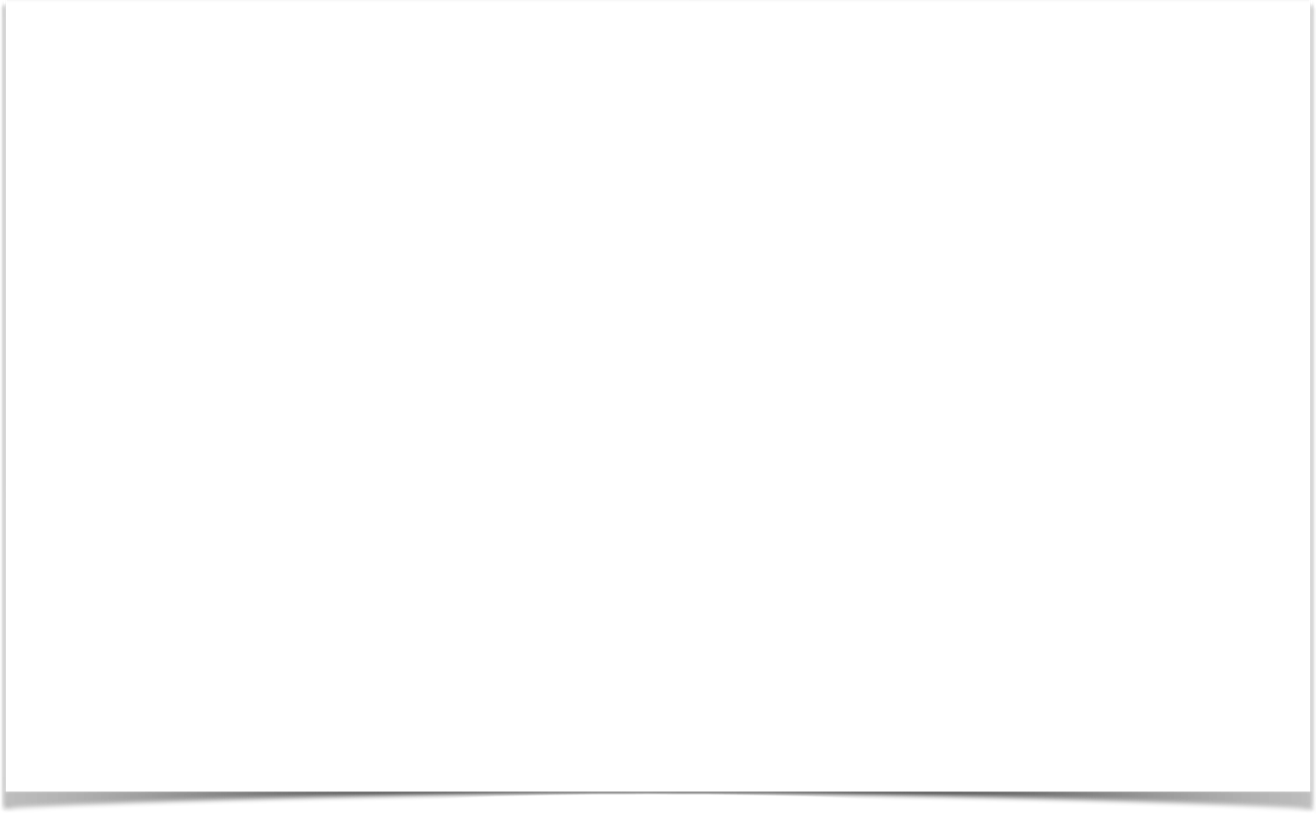
Controller Class
@Controller
public class HelloWorldController {
// need a controller method to show the initial HTML form @RequestMapping("/showForm")
public String showForm() { return "helloworld-form";
}
// need a controller method to process the HTML form @RequestMapping("/processForm")
public String processForm() { return "helloworld";
}
}
www.luv2code.com

Slide 15
Development Process
Step-By-Step
Create Controller class
Show HTML form
Create controller method to show HTML Form
Create View Page for HTML form
Process HTML Form
Create controller method to process HTML Form
Develop View Page for Confirmation
www.luv2code.com

Slide 16
Adding Data to Spring Model
Date

Slide 17
Focus on the Model
www.luv2code.com

Slide 18

Spring Model
The Model is a container for your application data
•
In your Controller
You can put anything in the model
strings, objects, info from database, etc…
•
Your View page (JSP) can access data from the model
www.luv2code.com

Slide 19
Code Example
•
We want to create a new method to process form data
•
Read the form data: student’s name
•
Convert the name to upper case
•
Add the uppercase version to the model
www.luv2code.com

Slide 20
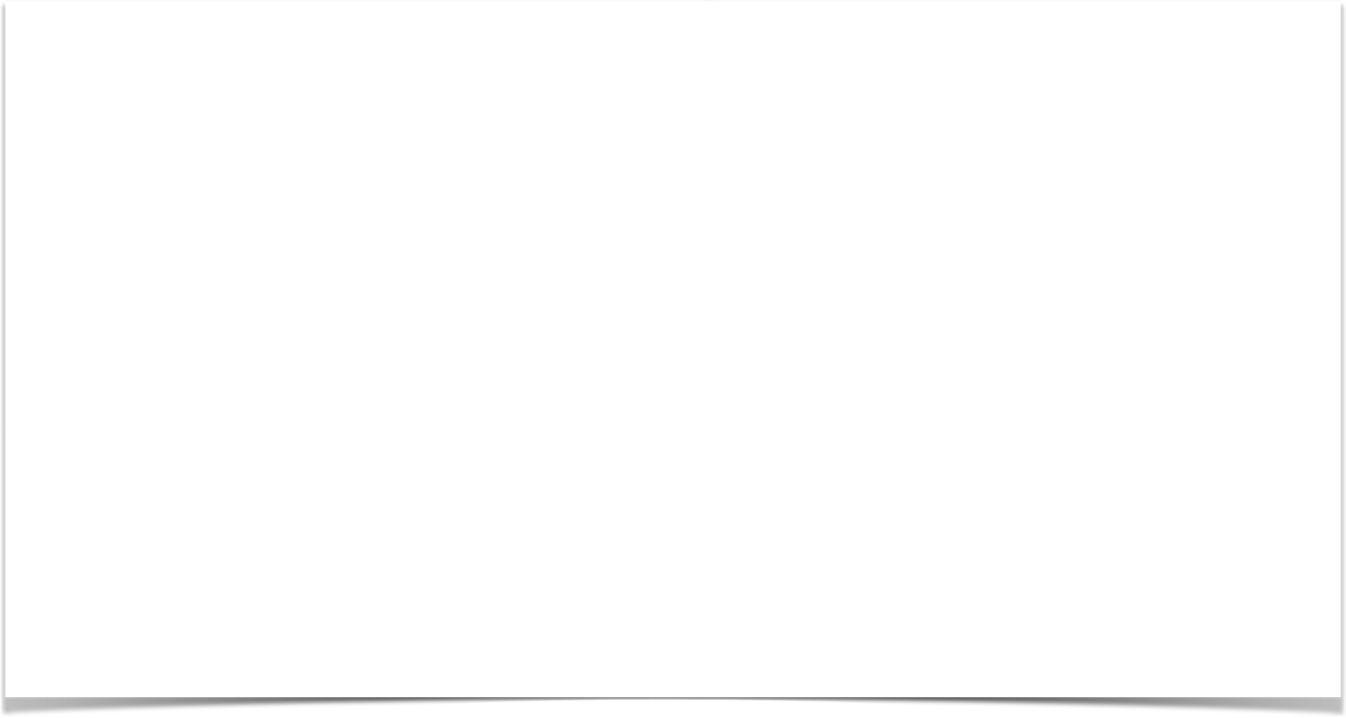
Passing Model to your Controller
@RequestMapping("/processFormVersionTwo")
public String letsShoutDude(HttpServletRequest request, Model model) {
// read the request parameter from the HTML form
String theName = request.getParameter("studentName");
// convert the data to all caps theName = theName.toUpperCase();
// create the message
String result = "Yo! " + theName;
// add message to the model model.addAttribute("message", result);
return "helloworld";
}
www.luv2code.com

Slide 21
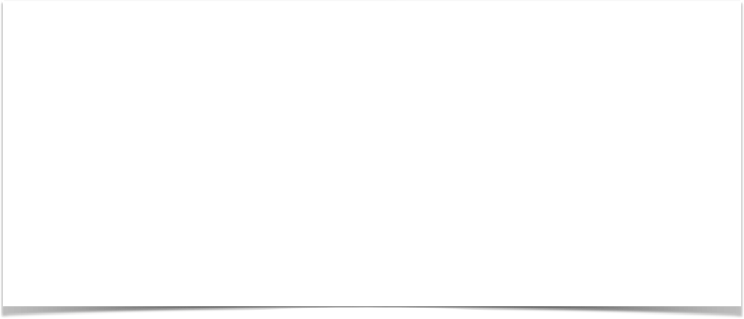
View Template - JSP
<html><body>
Hello World of Spring!
...
The message: ${message}
</body></html>
www.luv2code.com

Slide 22
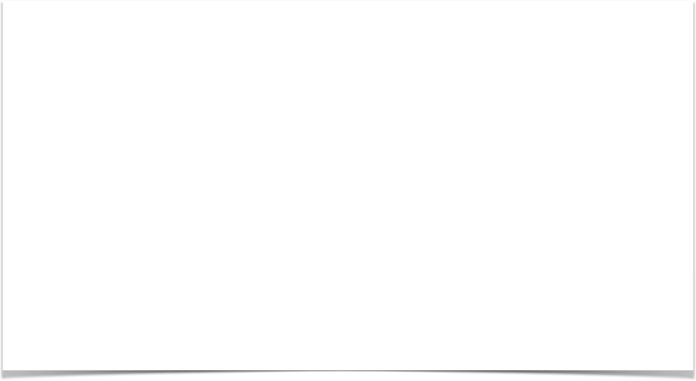
Adding more data to your Model
// get the data
//
String result = …
List<Student> theStudentList = … ShoppingCart theShoppingCart = …
// add data to the model
//
model.addAttribute("message", result);
model.addAttribute("students", theStudentList); model.addAttribute("shoppingCart", theShoppingCart);
www.luv2code.com

Slide 23
Reading HTML Form Data with @RequestParam Annotation
Date

Slide 24
Code Example
•
We want to create a new method to process form data
•
Read the form data: student’s name
•
Convert the name to upper case
•
Add the uppercase version to the model
www.luv2code.com

Slide 25
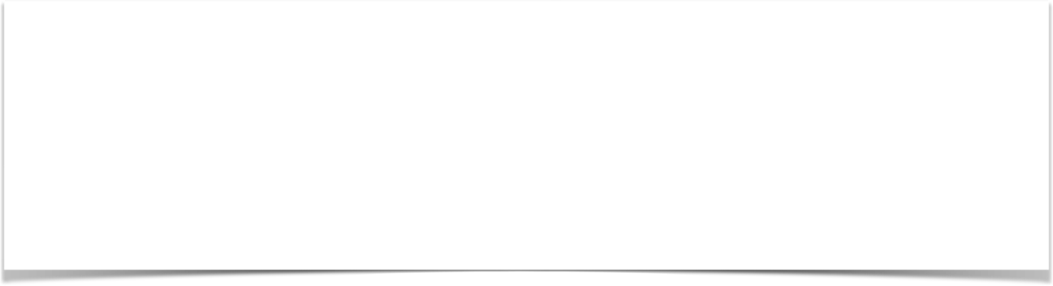
Instead of using HttpServletRequest
@RequestMapping("/processFormVersionTwo")
public String letsShoutDude(HttpServletRequest request, Model model) {
// read the request parameter from the HTML form
String theName = request.getParameter("studentName");
…
}
www.luv2code.com

Slide 26

Bind variable using @RequestParam Annotation
@RequestMapping("/processFormVersionTwo")
public String letsShoutDude( @RequestParam("studentName") String theName, Model model) {
// now we can use the variable: theName
}
Behind the scenes:
Spring will read param from request: studentName Bind it to the variable: theName
www.luv2code.com

Slide 27
Add Controller @RequestMapping
Date

Slide 28

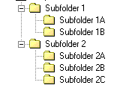
Adding Request Mappings to Controller
•
Serves as parent mapping for controller
•
All request mappings on methods in the controller are relative
•
Similar to folder directory structures
www.luv2code.com

Slide 29
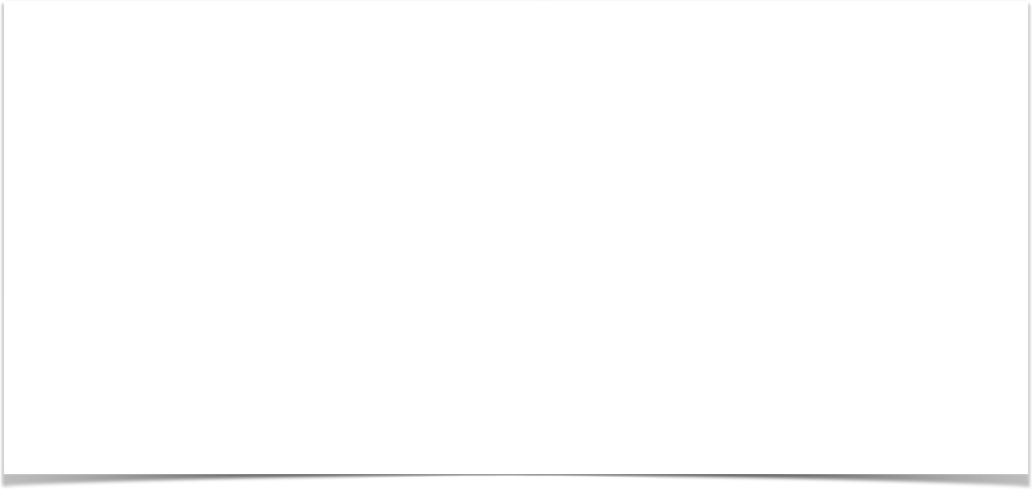


Controller Request Mapping
@RequestMapping("/funny") public class FunnyController {
@RequestMapping("/showForm") public String showForm() {
...
}
/funny/showForm
/funny/processForm
@RequestMapping("/processForm")
public String process(HttpServletRequest request, Model model) {
...
}
}
www.luv2code.com

